Slide 1


Drury Explorer
Development by: Daiv McBride, Daniel Chick, and Josef Polodna

Slide 2
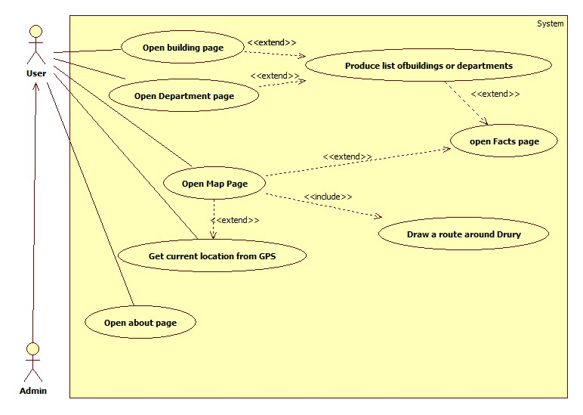
Use Case

Slide 3
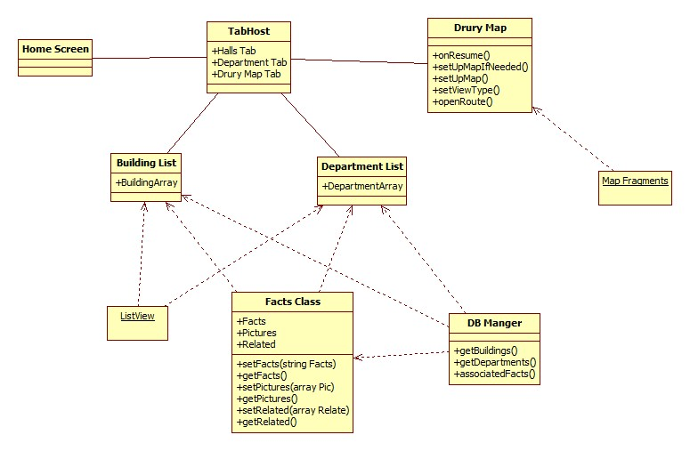
Class Diagram

Slide 4
What we learned about Google Maps
Need to include a layout to include buttons
Need a location listener to activate GPS

Slide 5
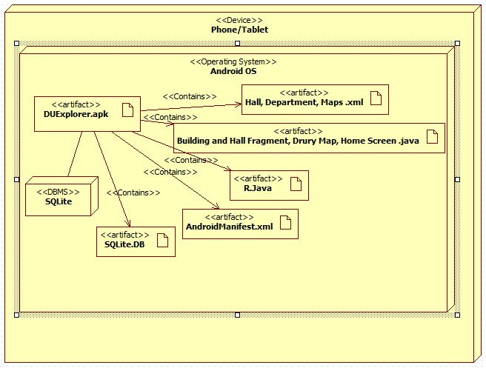
Deployment Model

Slide 6
What we learned about Git
User interface is not easy to learn
Social features concealed
You can commit and clone from Android Studio
Great for group projects
Some of the tutorials are not detailed enough

Slide 7
What we learned about SQLite
"Easily" implemented
Data stored within the app
Controlled in app through java classes
compiled into c
Great for small amounts of data that will not require updating

Slide 8
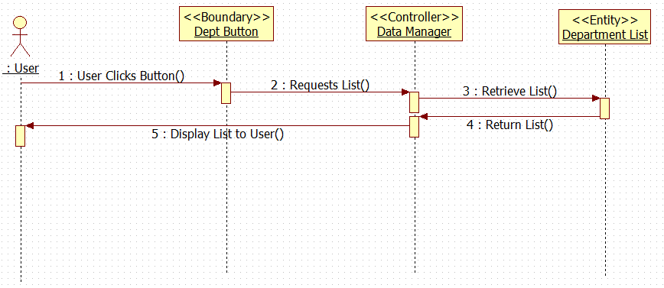
Sequence Diagrams

Slide 9
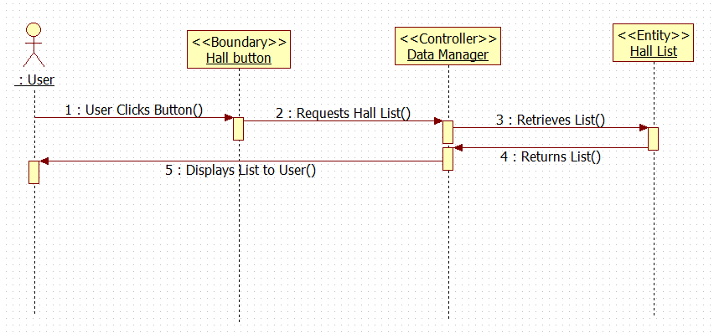

Slide 10
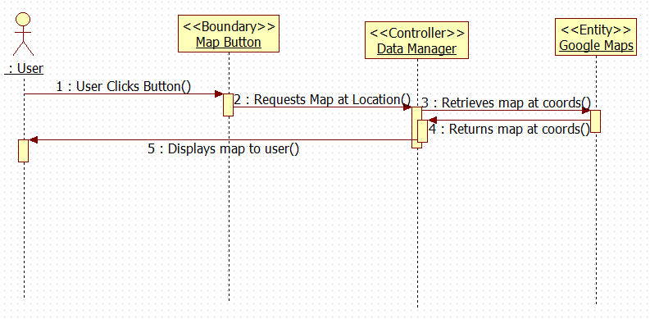

Slide 11
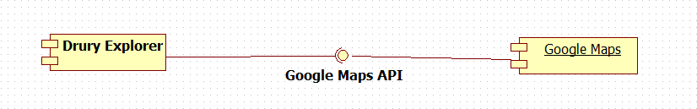
Component Diagram

Slide 12
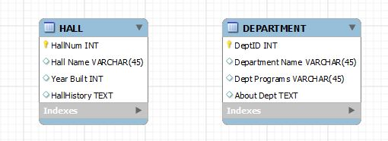
ERD

Slide 13
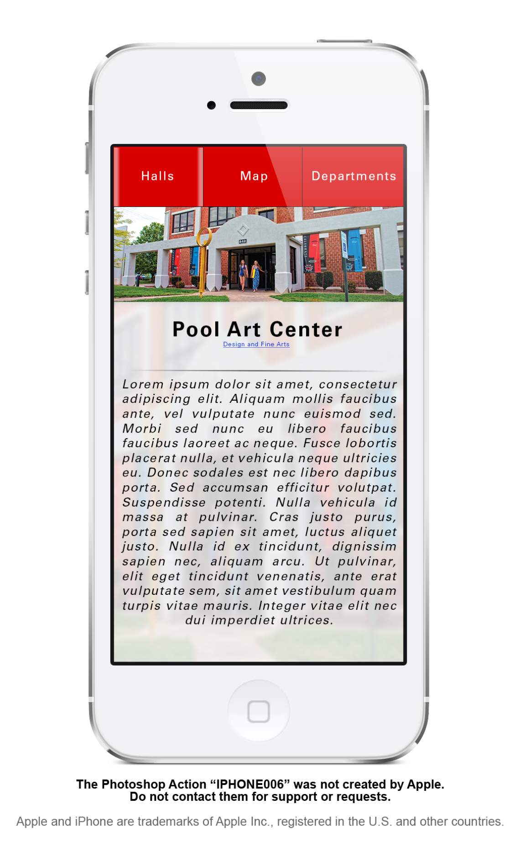
Design Template
This mockup was not created by Apple
Do not contact them for support or requests
Apple and iPhone are trademarks of Apple Inc., registered in the U.S. and other countries.

Slide 14
Acceptance Test Procedures
Pull up pages
Switch tabs
See Correct titles on tabs

Slide 15
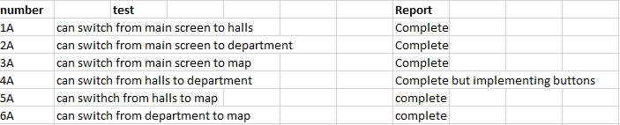

Testing

Slide 16
Current Issues
Action bar tabs
Activities are not linked to the tabs
Activities are linked to buttons on action bar
Pages
pages are not destroyed when going to new activity page
pages build up could cause a overload on phone

Slide 17
Transition Phase
Daiv
Use Case, Class Diagram
Daniel
Component, Sequence, Risk Analysis
Josef
Tech Plan, Deployment Diagram, Risk Analysis

